Slide 1



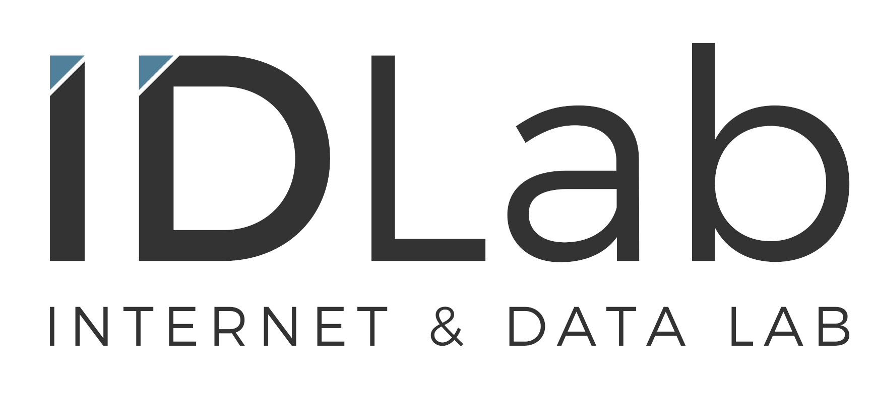
PErsoNal Genome QUery IN healthcare and clinical practice
PENGQUIN:
Elias Crum

Slide 2






Outline
Why?
Genomic Data + Health Care?
Goals
Reshape how genomic data is stored
How?
Ph.D. plan introduction
Impacts
Aspirations and future impacts

Slide 3
PENGQUIN
PErsoNal Genome QUery IN healthcare and clinical practice

Slide 4

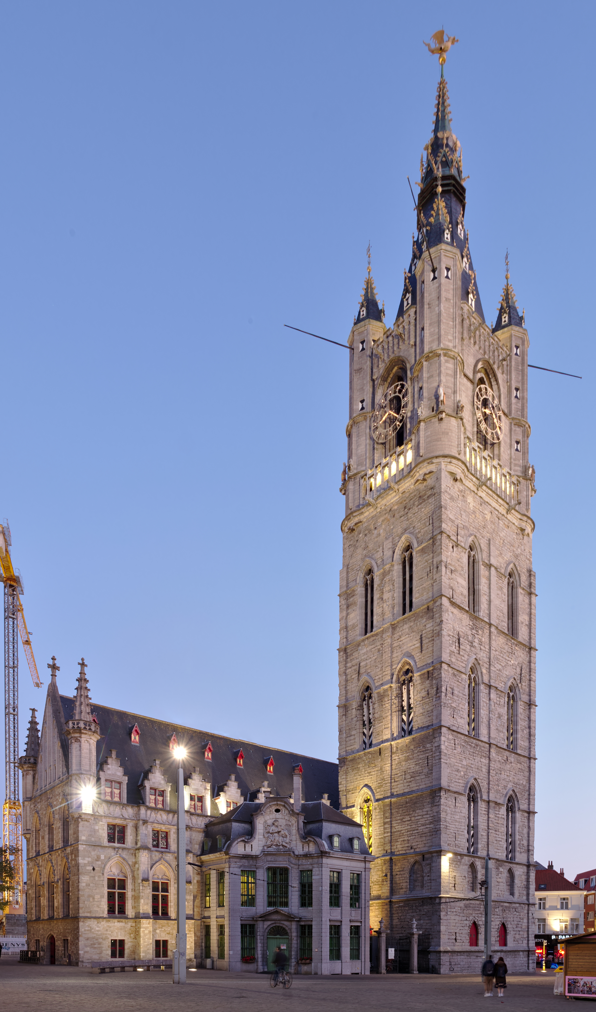



Personal Genome Sequence Data
Genome data is big...
~3.2 BILLION base pairs ----> ~1 GB
Sequencing output file ----> ~200 GB
Ghent Belfry
Variant Call Format (VCF) file ----> ~200 MB
Individual humans exhibit ~3 million mutations
VCF file records only those differences
~91m
~130m
Other considerations
Storage
Privacy
Printed
Human Genome¹
Governance
Formatting
Bergström et al. SCIENCE 20 Mar 2020.

Slide 5








Genome Data in Health Care
Institution-centric
Data Storage
Technological
Infrastructure
?
&
Cloud
On-site
Data Usage
Notes:
Tec

Slide 6
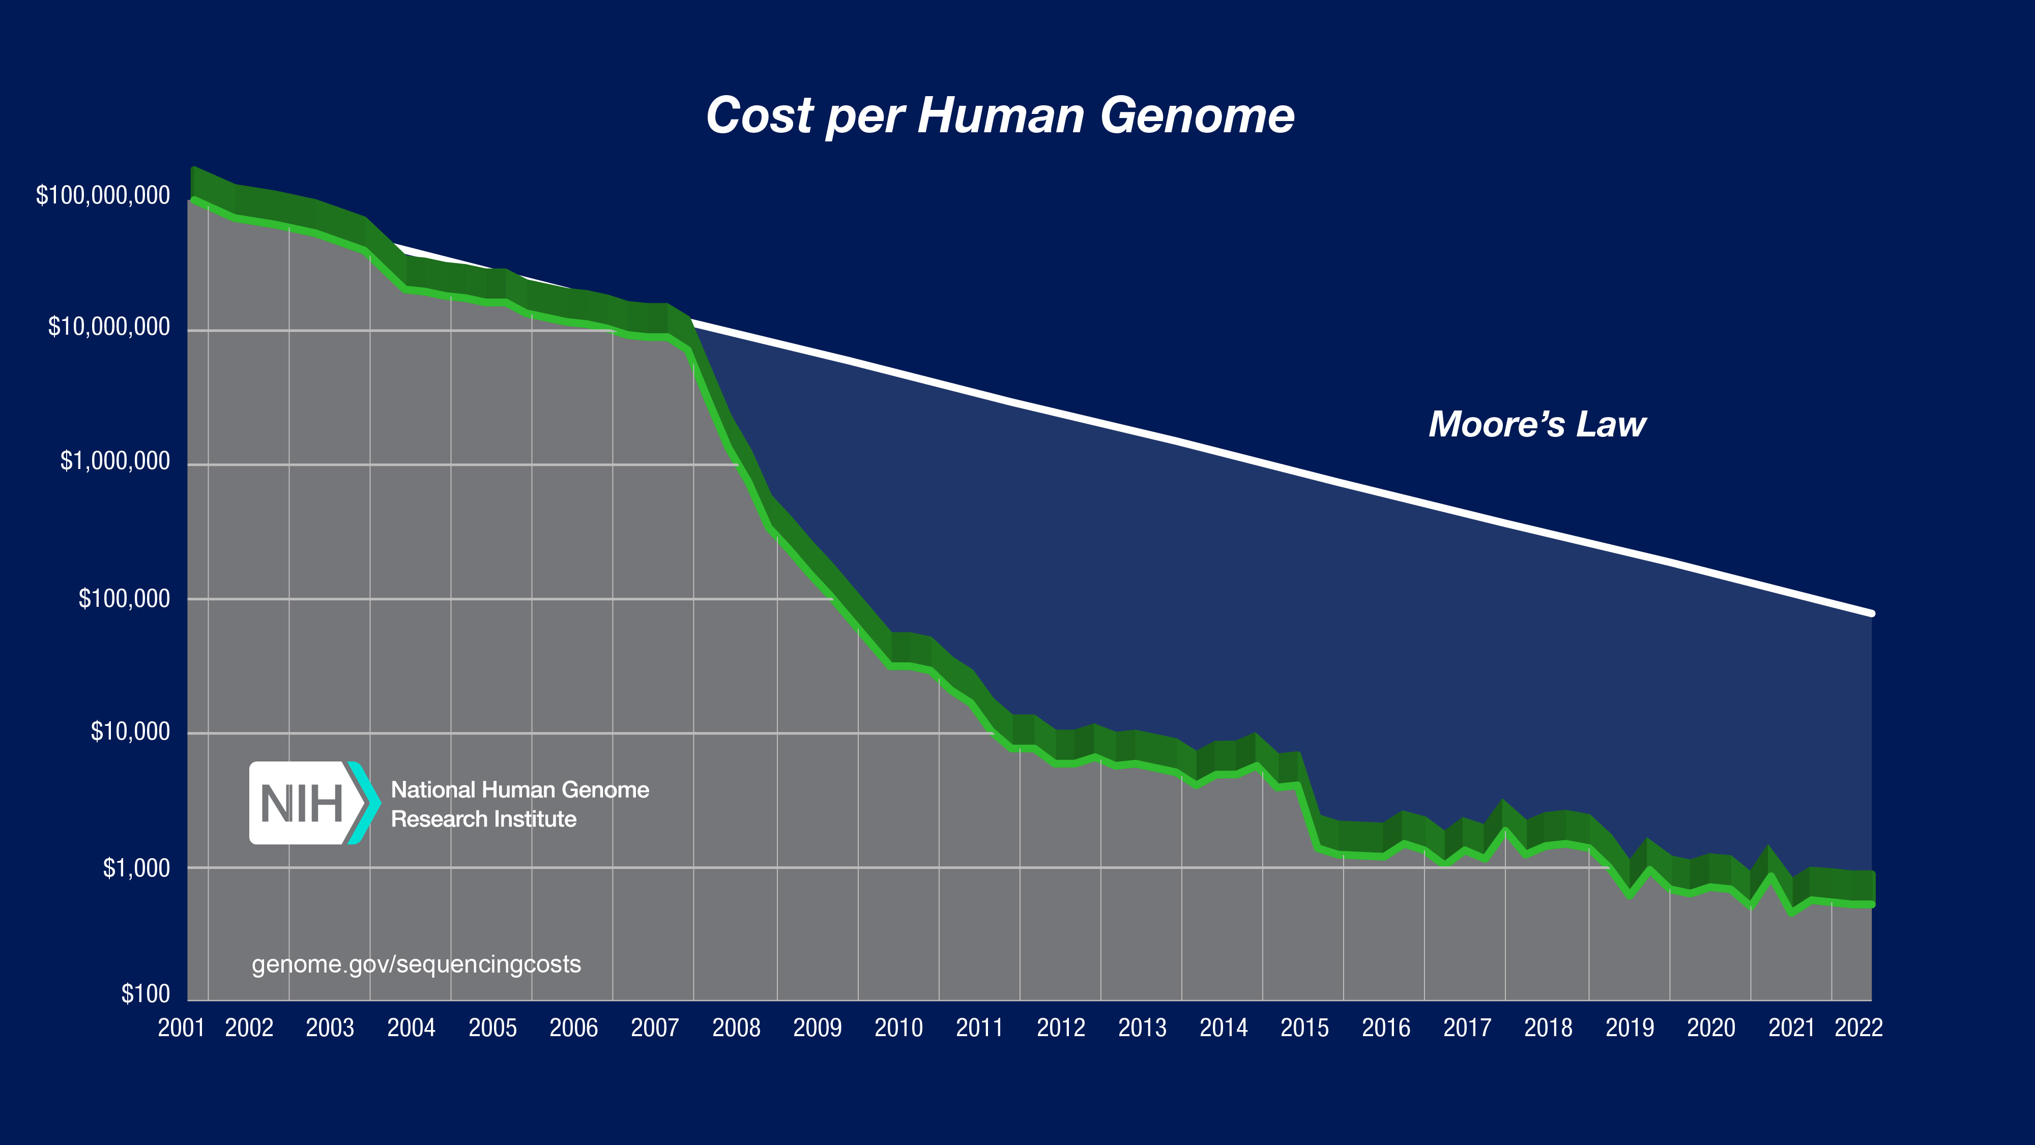
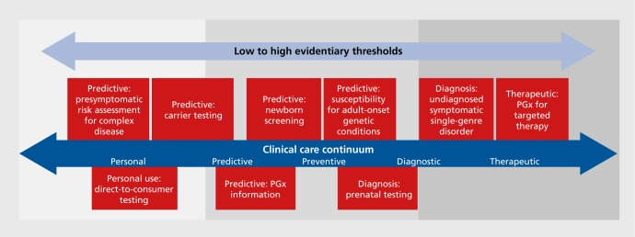
Genome Sequencing in Health Care
Sequence Generation Costs
Use-cases
10.31887/DCNS.2016.18.3/jkrier
Wetterstrand KA. Accessed 12/04/24.
Examples include:
Medication prescription (pharmacogenomics)
Genetic disease screening
Cancer diagnosis & treatment
Currently getting close to $100 per genome⁴
Per-base cost of sequencing has been dropping by half every ~5 months
Per-base cost of sequence data storage is dropping by half every ~14 months

Slide 7
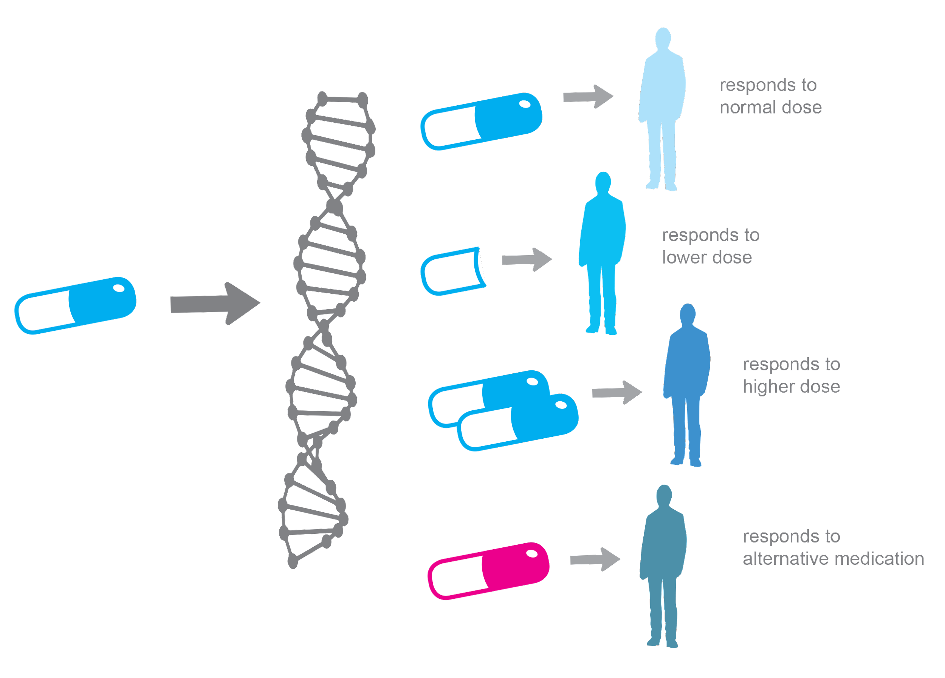
Personalized Medicine
All human diseases are influenced by genetics
Personalized Medicine = Medical care informed by an individual’s genetic profile
Examples:
Drug prescription
Cancer diagnosis
Cancer therapy development and targeting
Genetic disease screening
Jackson et al. Essays Biochem.3 Dec 2018.
https://alphagenomix.com/empowering-personalized-medicine/

Slide 8
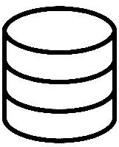

Sequencing and Storage Costs
By 2025, it is projected that human genome sequence storage will surpass cumulative data stored from social media platforms
<
Stevens et al. 2015. https://doi.org/10.1371/journal.pbio.1002195

Slide 9



Scaling Genome Data Usage
Research genomic data sharing initiatives:
State-of-the-art for clinical genomic data sharing?
GDPR (EU) / HIPPA (US) *EU Health Data Spaces*
Not much...

Slide 10
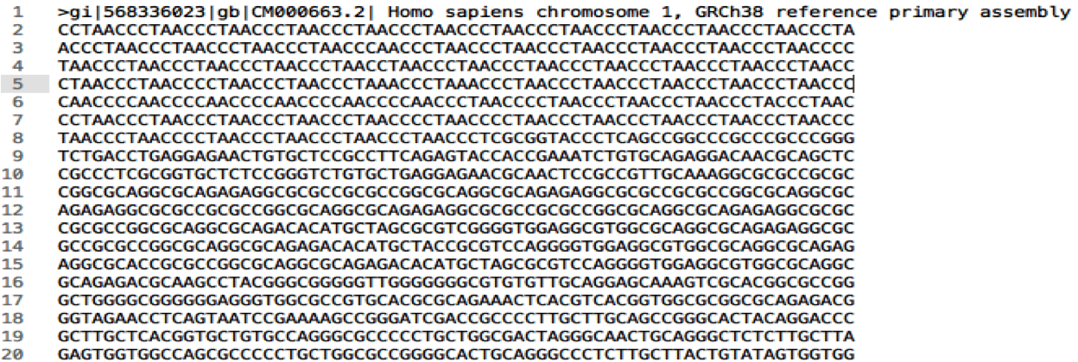
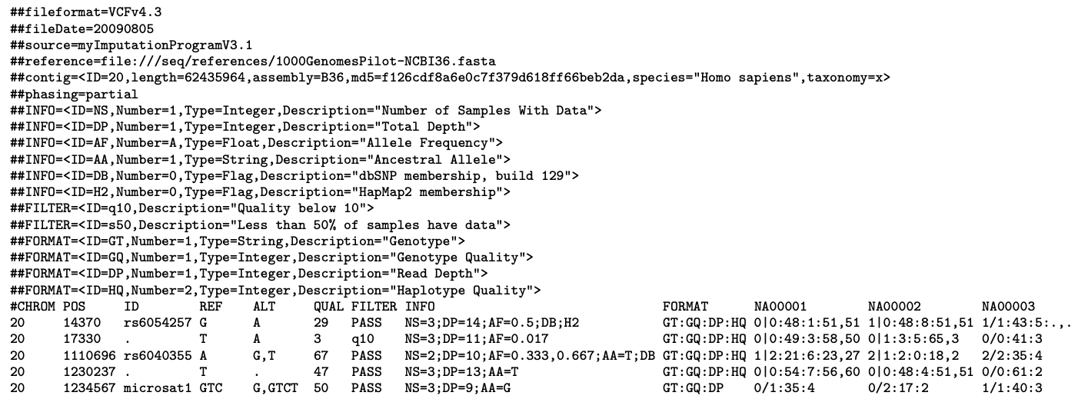
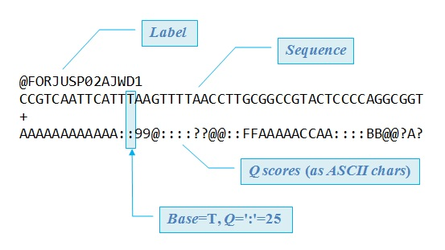
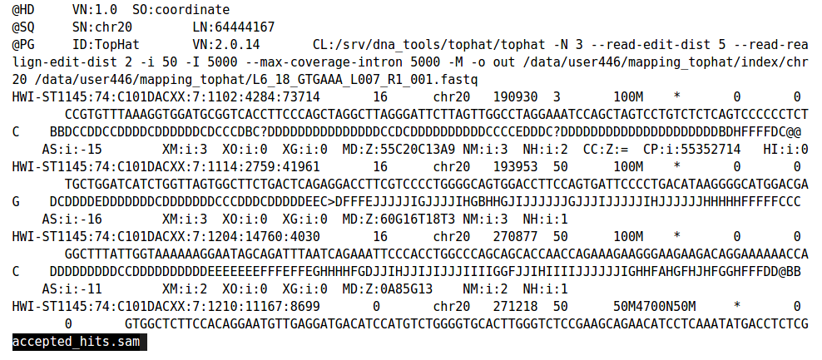
Sequence Data Formats
FASTQ
FASTA
SAM/BAM
VCF
Raw Sequencing Outputs
Contiguous DNA sequence
FASTQ reads aligned to a FASTA reference
Areas in SAM where sample and reference differ

Slide 11
Sequencing Storage
The human genome = ~3 billion base pairs
3 billion letters -- ~700 megabytes
Representative of a single strand of the whole human genome sequence
E.g. : …ATGCCGTAAACAGATGTCA …
Format: TXT file
Raw human whole genome sequence -- ~200 gigabytes
Whole genome sequences typically have >=30x coverage at each base position. (i.e. each base of the genome is represented in the sequence file a >= 30 times)
Format: FASTQ file
Aligned human whole genome sequence -- ~210 gigabytes // ~100 gigabytes // ~15 gigabytes
Whole genome sequence is mapped to a reference human genome and can be stored in various formats. Recent advances have allowed for improved compression.
Format: SAM file // BAM file // CRAM file
Human genome variant file (list of mutations) -- ~125 megabytes
Individual humans only exhibit ~0.1% variation comparatively (~3 million mutations). Variant file records those differences in one individual’s genome compared to the “normal” reference genome.
Format: VCF file

Slide 12
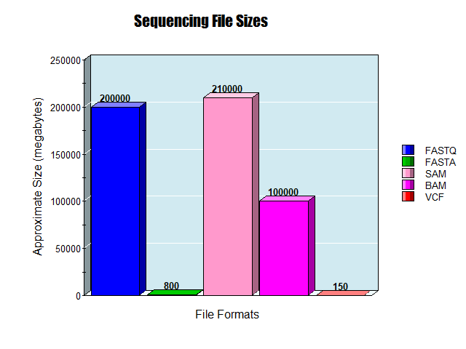
Sequencing File Sizes
FASTQ
~ 200 gigabytes
~ 800 megabytes
FASTA
~ 210/100 gigabytes
SAM/BAM
~ 150 megabytes
VCF
https://nces.ed.gov/

Slide 13
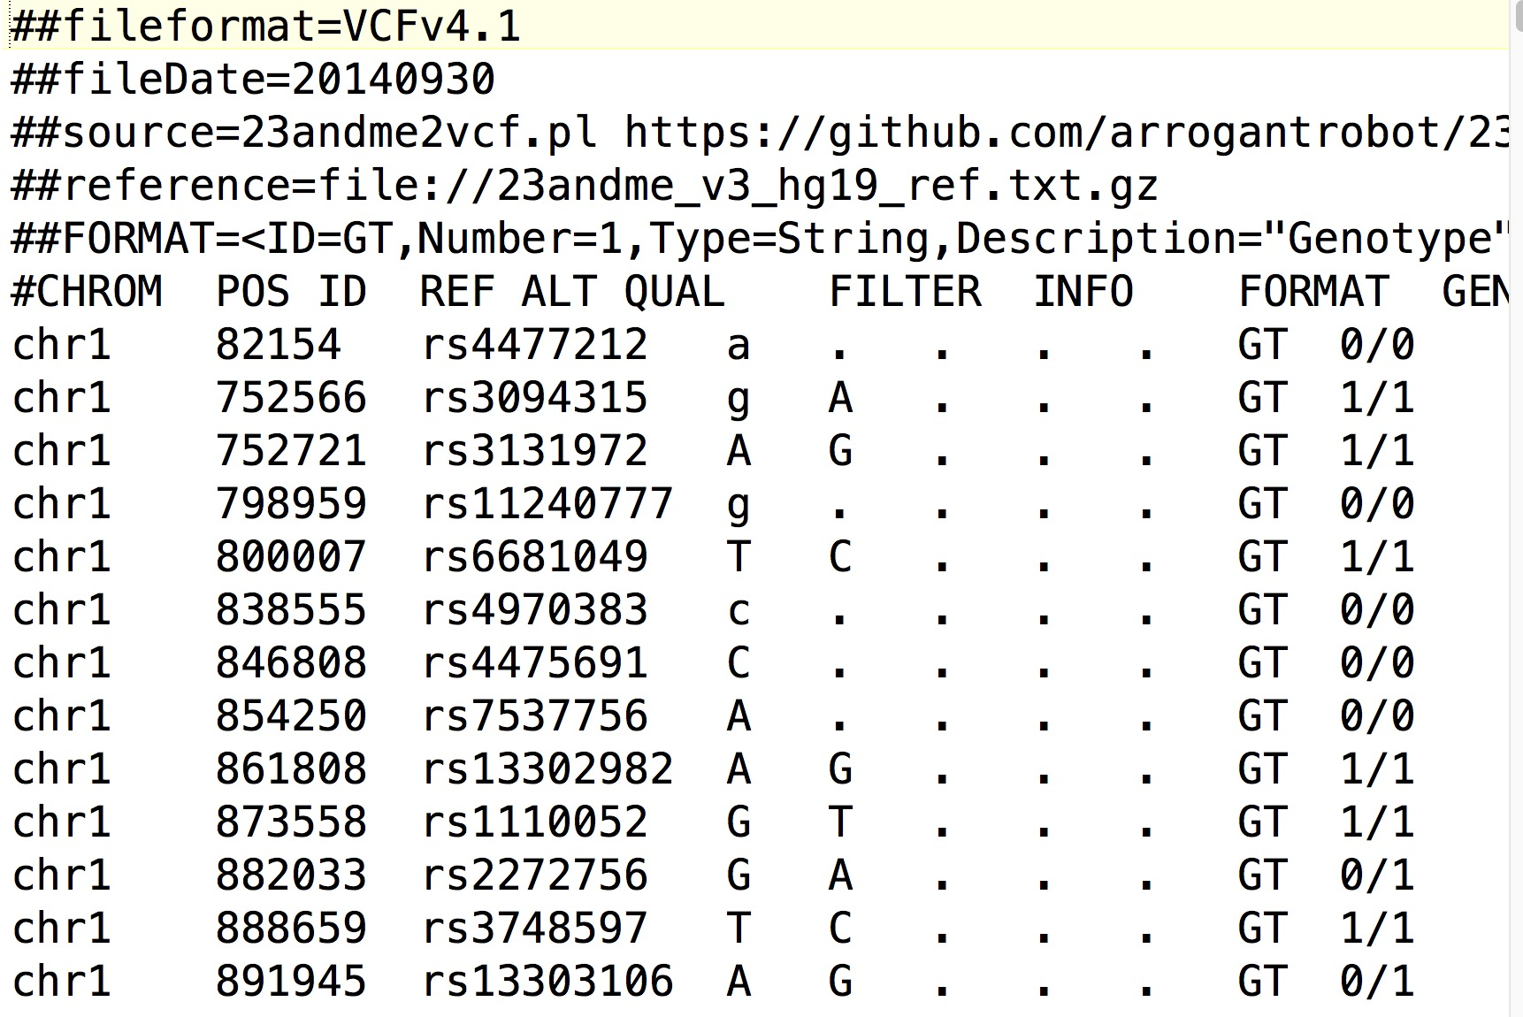
Variant Call Format (VCF)
- tab delimited .txt file
- Rows represent individual mutations in a sequence (when compared to reference)
- Columns store information about that mutation

Slide 14




Research Questions
1. Can Solid² be implemented for genomic data storage?
What is the impact on data policy enforcement?
2. Can (VCF) genomic data be represented as RDF?
?
+
Can genomic and other medical data be linked semantically?
3. Can RDF genomic data be queried in a useful way?
Can this improve genomic data discoverability for researchers?

Slide 15

Project Goals
To develop a proof-of-concept
Framework and Web Application for:
Genomic data storage in Solid Pods
Granular privacy controls of genomic data
Genomic data representation in RDF
Data-linking potential
Data querying potential (within and across pods)

Slide 16


Project Goals
But wait...
This sounds like an ENGINEERING project!
Where is the RESEARCH??

Slide 17


Project Goals – (1a) Storage
1. Can Solid² be implemented for genomic data storage?
Solid pod instances
Community Solid Server⁴
VCF Genomic Data
Illumina Platinum Genomes⁵
Patient 1 Genome Data
VCF File
Data Ingestion
VCF File
Patient 1 Genome Pod
** What about data policy enforcement (privacy)?

Slide 18
Project Goals – (1b) Storage
1. Can Solid² be implemented for genomic data storage?
ACL policy controls
???????
** What about data policy enforcement (privacy)?
Patient 1 Genome Data
VCF File
Data Ingestion
VCF File
Patient 1 Genome Pod

Slide 19

Project Goals – (2a) Formatting
2. Can (VCF) genomic data be represented as RDF?
VCF to RDF Vocabularies exist
SPHN Semantic Interoperability Framework⁵
+ FHIR HL7 Format⁶
Conversion tools / strategies do not...
Can genomic and other medical data be linked semantically?

Slide 20

Project Goals – (3a) Querying
3. Can RDF genomic data be queried in a useful way?
Query Engine
Custom Comunica implementation/engine⁶
VCF File
VCF File
VCF File
Patient 1 Genome Pod
Patient 1 Genome Pod
Patient 1 Genome Pod

Slide 21
Project Goals – (3b) Querying
3. Can RDF genomic data be queried for research?
VCF Genomic Data
Illumina Platinum Genomes⁵

Slide 22
Workflow Overview
Goal 1a
Goal 2a/b
Goal 1b
VCF File
Patient Genome Pods
VCF File
VCF File
Query Engine
Goal 3b
Goal 3a

Slide 23
Implementation Specifics
Solid pod instances
Community Solid Server⁴
Genomic Data
Publicly available VCF data⁴
RDF Conversion
Aim to use SPHN RDF vocabulary⁵
Data-linking
Actively exploring ontologies / methodologies
Data Querying
Custom instance of Comunica⁶

Slide 24
Solid Technology
Does not solve ALL problems, but offers an environment where improvements are possible
Easier sharing (web-facilitated)
Granular privacy controls
Direct patient data access
Data representation flexibility (RDF)
Possibility of data-linking and querying

Slide 25
Thoughts about a solution
Large knowledge graph traversal is not a trivial querying problem
Current ideas for achieving “good” performance:
Genomic linked data structure leveraging
Gene locus / quality filtering / etc.
Search caching in query engine
Pre-computed summaries / indexes for more efficient data “location” determination

Slide 26





Future Directions
Basic Functionalities:
Genomic data storage in Solid pods
Data privacy management
Data Sharing via the web
Experimental research:
Represent genomic data as RDF?
Linking genomic and health data?
Single and Many pod Querying?

Slide 27
Questions?

Slide 28
Sources
https://bio4.us/biotrends/human_genome_height.html
Tse, G. et al. Genotype‐guided warfarin dosing vs. conventional dosing strategies: a systematic review and meta‐analysis of randomized controlled trials. 2018. https://doi.org/10.1111%2Fbcp.13621
Wetterstrand KA. DNA Sequencing Costs: Data from the NHGRI Genome Sequencing Program (GSP) www.genome.gov/sequencingcostsdata. Accessed 12/04/24.
https://www.ultimagenomics.com/publications-and-resources?filter=Literature
van der Horst E, et al. Bridging Clinical and Genomic Knowledge: An Extension of the SPHN RDF Schema for Seamless Integration and FAIRification of Omics Data. 2023. https://doi.org/10.20944/preprints202312.0373.v1
Dolin RH, et al. vcf2fhir: a utility to convert VCF files into HL7 FHIR format for genomics-EHR integration. 2021 Mar. doi: 10.1186/s12859-021-04039-1.

Slide 29
Sources
Slide 6 (Sequencing Storage):
Cock, P. J. A., Fields, C. J., Goto, N., Heuer, M. L. & Rice, P. M. The Sanger FASTQ file format for sequences with quality scores, and the Solexa/Illumina FASTQ variants. Nucleic Acids Res 38, 1767–1771 (2010).
Li, H. et al. The Sequence Alignment/Map format and SAMtools. Bioinformatics 25, 2078–2079 (2009).
Bonfield, J. K. CRAM 3.1: advances in the CRAM file format. Bioinformatics 38, 1497–1503 (2022).
Danecek, P. et al. The variant call format and VCFtools. Bioinformatics 27, 2156–2158 (2011).

Slide 30
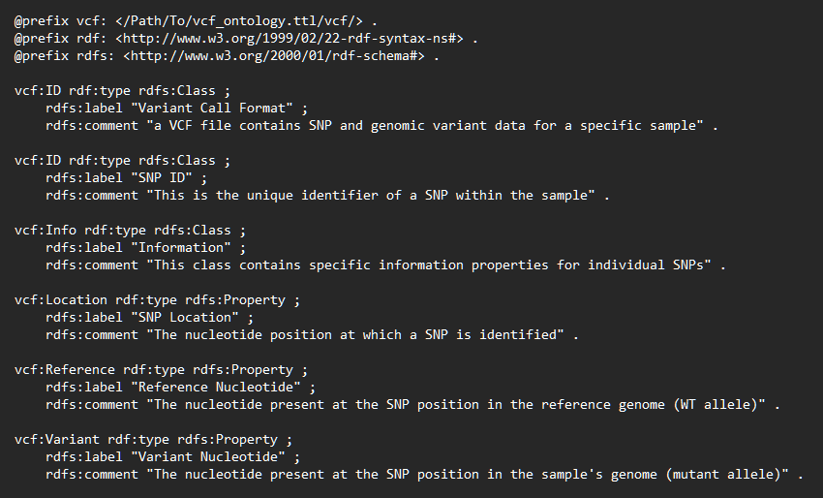
Ontology Definition
Predicate
Subject
Object
Resource Description Format (RDF):
Allele
Gene_A1
“C”
Defining an ontology:

Slide 31
Industrial / Societal relevance
Societal:
Consumer in control of their own data
Unintended consequences → disruptive in established data flows
this is researched in We Are (among other things)
Ethical sharing of personal data for research purposes
VITO PhD of Cato Van Schyndel (Health Unit)
Industrial:
Personalized services based on data controlled by users
At VITO, project “SAVE DATA”
proof-of-concept with companies on solid-based commercial applications
Not explored yet for genome data specifically

Slide 32
Sequencing Storage
The human genome = ~3 billion base pairs
3 billion letters == ~700 megabytes
Representative of a single strand of the whole human genome sequence
E.g. : …ATGCCGTAAACAGATGTCA …
Format: TXT file
Raw human whole genome sequence == ~200 gigabytes
Whole genome sequences typically have >=30x coverage at each base position. (i.e. each base of the genome is represented in the sequence file a >= 30 times)
Format: FASTQ file
Aligned human whole genome sequence == ~100 gigabytes // ~15 gigabytes
Whole genome sequence is mapped to a reference human genome and can be stored in various formats. Recent advances have allowed for increased compression.
Format: BAM file // CRAM file
Human genome variant file (list of mutations) == ~125 megabytes
Individual humans only exhibit ~0.1% variation comparatively (~3 million mutations). Variant file records those differences in one individual’s genome compared to the “normal” reference genome.
Format: VCF file

